Slide 1
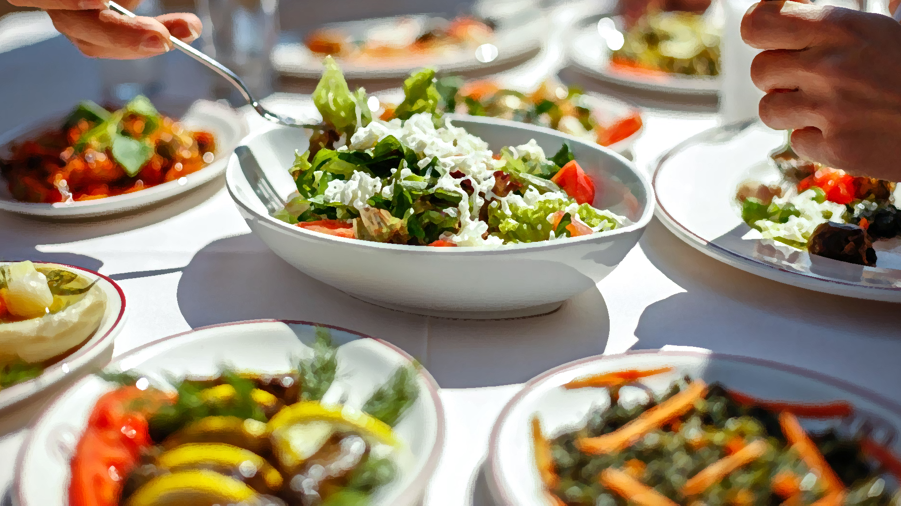
Calorie-Based Meal Advisor
SE 403 Software Project Management – Team 1 Term Project

Slide 2
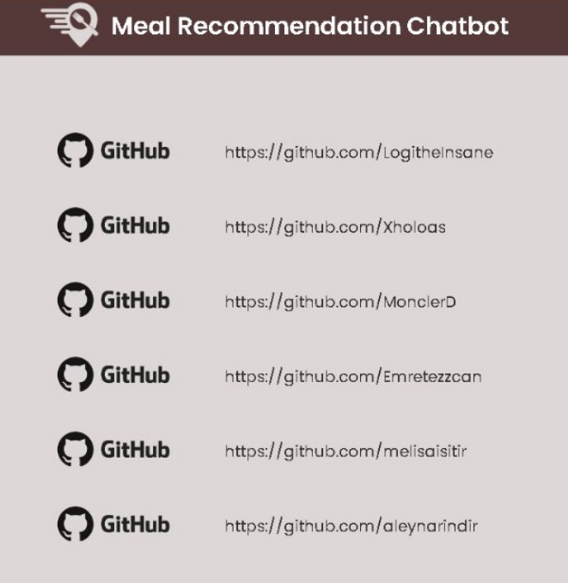
Project Members
Instructor: Ensar Gül
Canberk Kızılkaya (Scrum Master)
Emin Mert Demirci
Aleyna Narin
Melisa Işıtır
Tolga Koraş
Emre Tezcan

Slide 3
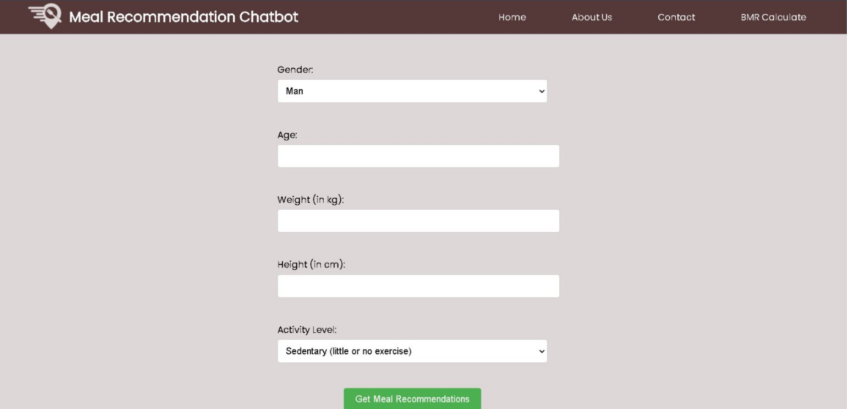
Project Introduction
Our project is a calorie-based meal advisor done with ChatGPT technology. It has two options: one is where the user can get a specific meal recommendation where he can decide its total calories; the other one is where the user enters his information, and the program offers a meal plan according to his calorie needs.

Slide 4










Used Technologies in the Project
ChatGPT
Flask
HTML
CSS
JavaScript
Python
Visual Studio Code
GitHub
Trello
Discord

Slide 5
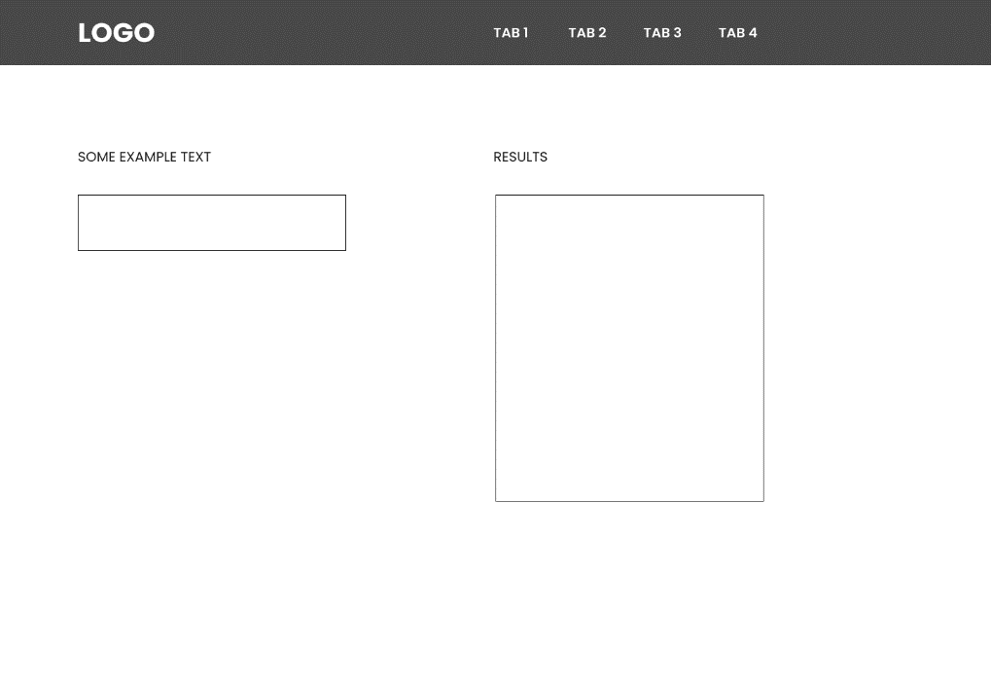
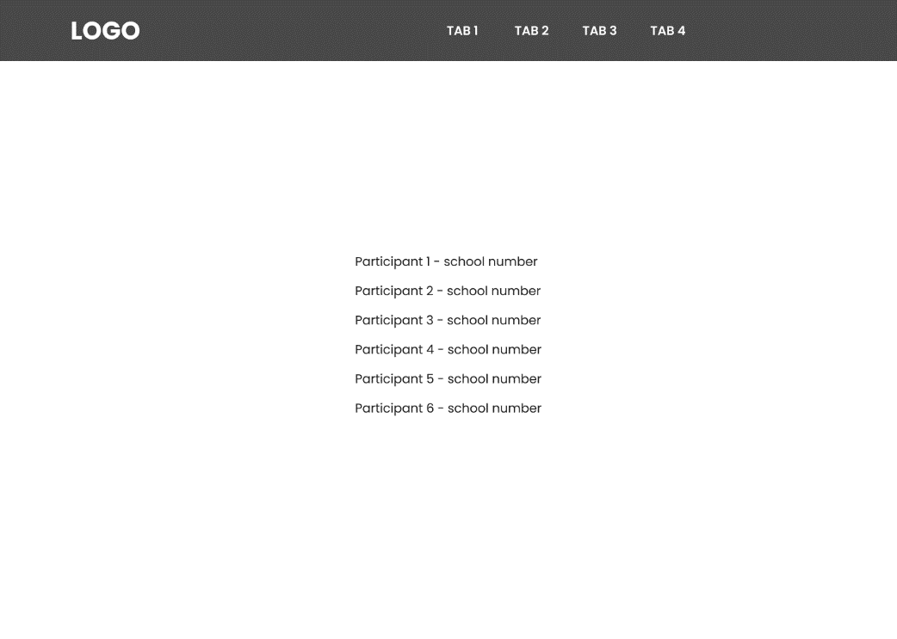
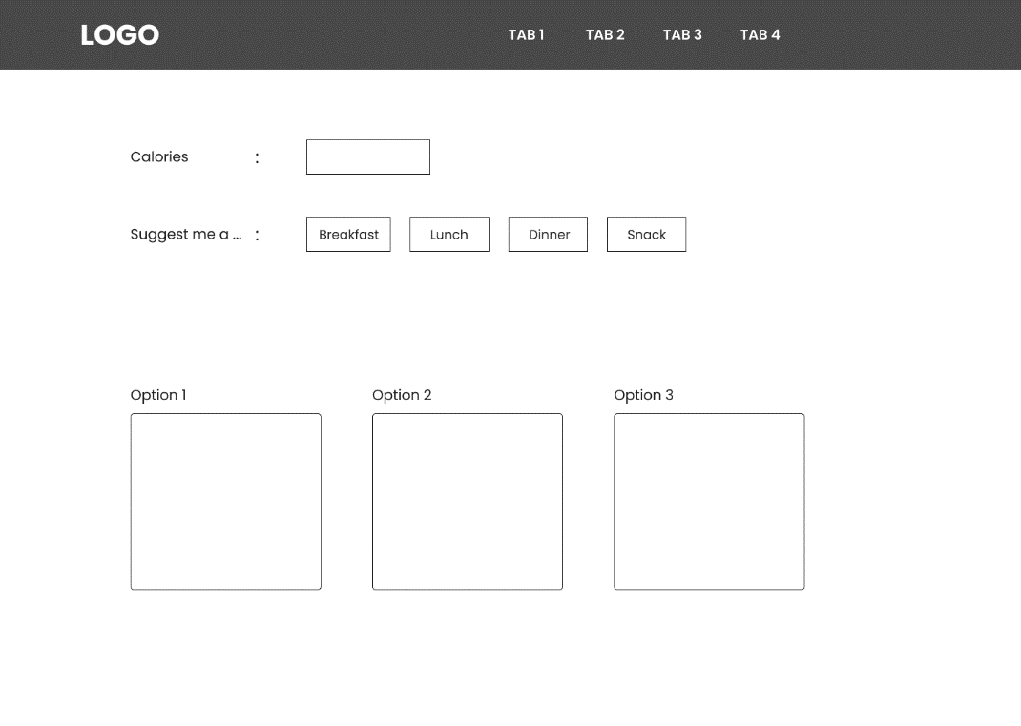
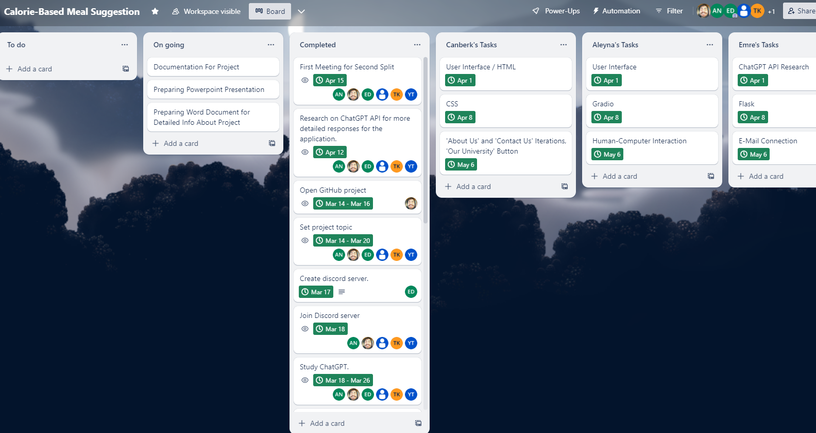
Project’s Design Documents
Figures: Webpage’s Design Documents and Our Trello Design

Slide 6
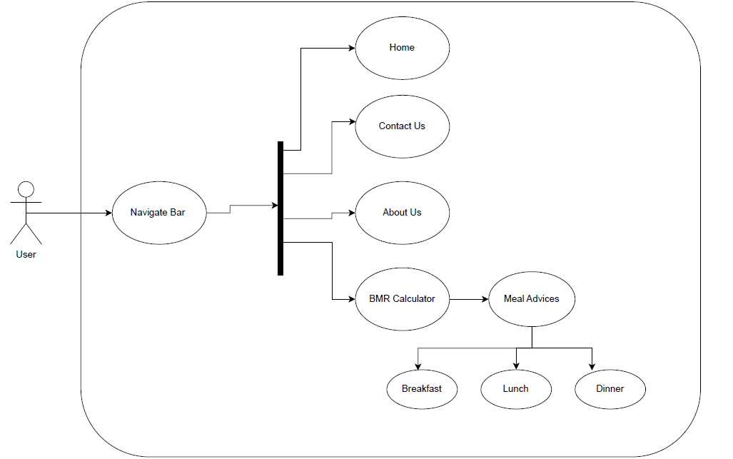
Project’s Use Case Diagram
Figure: UML Use Case Diagram

Slide 7
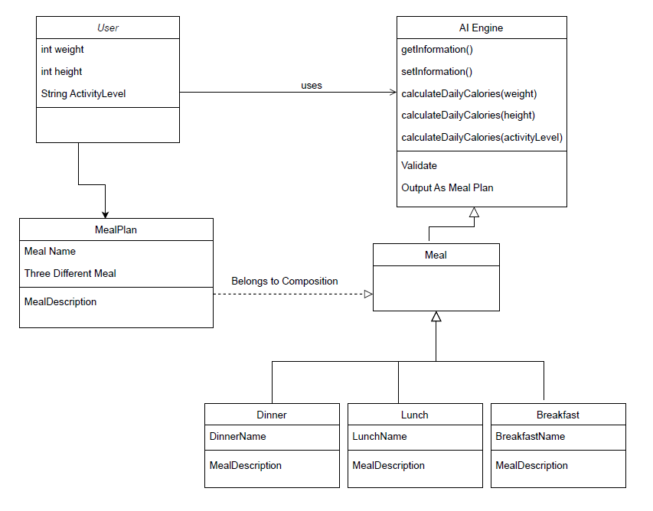
Project’s Class Diagram
Figure: UML Class Diagram

Slide 8
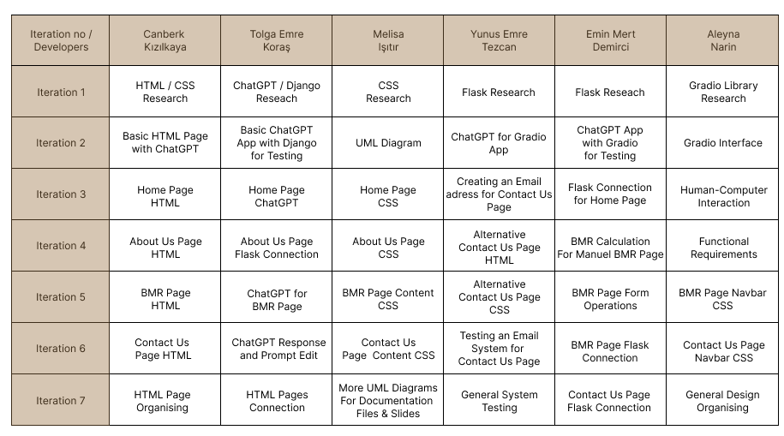
Working as a Group in the Project
Figure: Each group member’s tasks week by week.

Slide 9
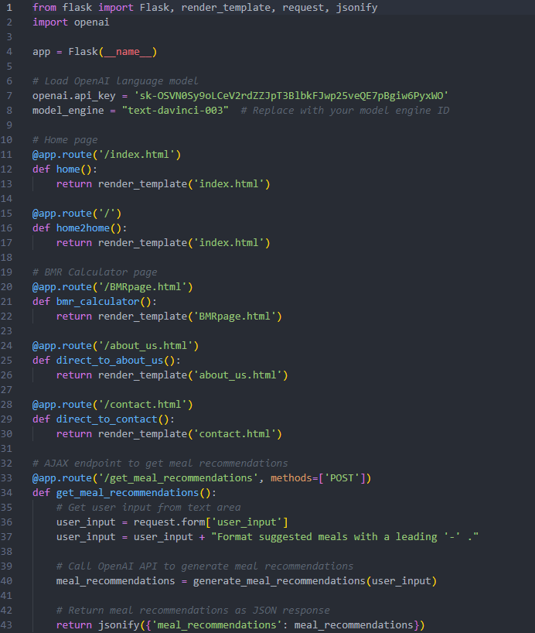
Project’s Source Code
Figure: An example part of our Python code. Full code can be found in: https://github.com/LogitheInsane/se-403-spring-22-team-1

Slide 10
Project’s Functional and Non-Functional Requirements
FUNCTIONAL REQUIREMENTS:
Meal Recommendation: The app should recommend meals to the user based on their preferences and dietary restrictions. Meal recommendations should be created by the artificial intelligence engine and personalized according to the user's needs.
Creating Meal Plan: The app should allow the user to create a meal plan based on suggested meals. The user should be able to set the duration of the meal plan and add or remove meals.
Nutrition Information: The app should provide nutritional information such as calorie count, macronutrient breakdown and ingredient list for each meal recommendation.
Additional requirements may include a meal history feature, meal customization options, and more.
NON-FUNCTIONAL REQUIREMENTS:
Performance: The app should be able to quickly generate meal plans based on user preferences and dietary restrictions. It should be able to handle a large number of users at the same time without slowing down or crashing.
Reliability: The app should be able to generate accurate meal plans that meet the user's dietary requirements consistently. It should also be able to handle errors and exceptions gracefully.
Security: The app should protect user data, such as dietary preferences and health information, from unauthorized access and ensure that the data is stored securely.
Usability: The app should be easy to use and navigate, with a simple and intuitive interface. It should also be accessible to users with disabilities.
Scalability: The app should be able to handle an increasing number of users and data over time, without sacrificing performance or reliability.
Maintainability: The app should be easy to maintain and update, with clean and well-documented code. It should also be easy to troubleshoot and fix any issues that arise.

